Slide 1
CS 766 - SPEECH TO LIP SYNC GENERATION
Elizabeth Murphy, Abhay Kumar, Maryam Vazirabad
Notes:
Hi everyone. Today we will discuss the problem of lip-syncing a talking face video to match a target speech segment to the lip and facial expression of the person in the video. This can also be referred to as an audio deepfake.
The primary task is to achieve accurate audio-video synchronization given a person’s face in a static image or video and a target audio clip.

Slide 2
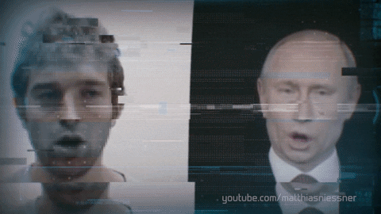
Speech to Lip Sync Generation
Purpose:
lip-syncing a talking face video to match the target speech segment to the lip and facial expression of the person in the video
Applications:
realistic dubbing in movies, CGI animations in movies, and gaming.
Deepfake Technology
emerging form of synthetic media
state of the art models are so convincing that they have the potential to deceive
Notes:
Speech to lip sync generation is the process of lip syncing a video of a person speaking to match a speech segment to the lip and facial expression of that person.
Some applications of deep fakes with audio only include realistic foreign language dubbing in movies, CGI animation in movies, conversational agents, and gaming.
Deepfakes are an emerging form of media produced by techniques in machine learning and artificial intelligence. Deepfake technology can not only dub audio content seamlessly onto someone's face, but it can also copy another person's likeness entirely. State of the art models have become so convincing that it can be hard to tell if they are real and so they also have the potential to deceive.

Slide 3
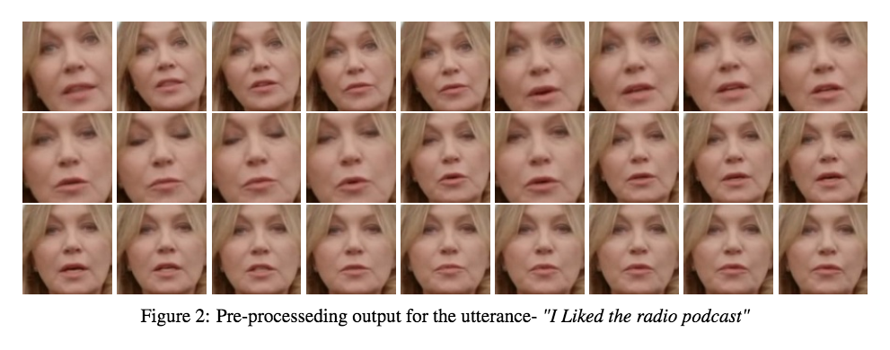
Dataset / Preprocessing
Notes:
We trained the model on a large speech recognition dataset, LRS2, which consists of thousands of spoken sentences from BBC television.
For preprocessing, we extracted the frames, trimmed the face coordinates of the speaker, and detected the speaker face from the video frames. Each detected face was then resized, and an example of the finalized outputs of our preprocessing is shown here on the slide.

Slide 4
Architecture of Network
[1]
Notes:
The main methods for creating deepfakes are generative adversarial networks (GANs for short) or autoencoders. The network we employed, LipGAN, uses an adversarial model composed of a generator and discriminator. The generator generates faces by mapping to the audio inputs while the discriminator tests if the face and audio are in sync by classifying in sync or out of sync speaking behavior. The generator consists of three different branches.
The first branch is the Face Encoder. The face encoder is a convolutional neural network (or CNN) that encodes the face features, including identity and pose.
The second branch is the audio encoder. The audio encoder is a standard CNN model that takes a Mel-frequency cepstral coefficient (MFCC) heatmap and creates an audio embedding. The last branch is the Face Decoder. The face decoder is a module that synthesizes a lip-synchronized face from the joint audio-visual embedding by inpainting the masked region of the input image with an appropriate mouth shape.
The discriminator uses contrastive loss between the encoded audio and encoded face to supervise the generator module. Contrastive loss is a distance function that takes the output of the network for a true encoding and calculates its distance to an example of the same class and subtracts that with the distance of a false encoding. By the discriminator minimizing the contrastive loss, the generator module can improve the learning of speech mappings to produce deepfakes with more natural facial movements.

Slide 5
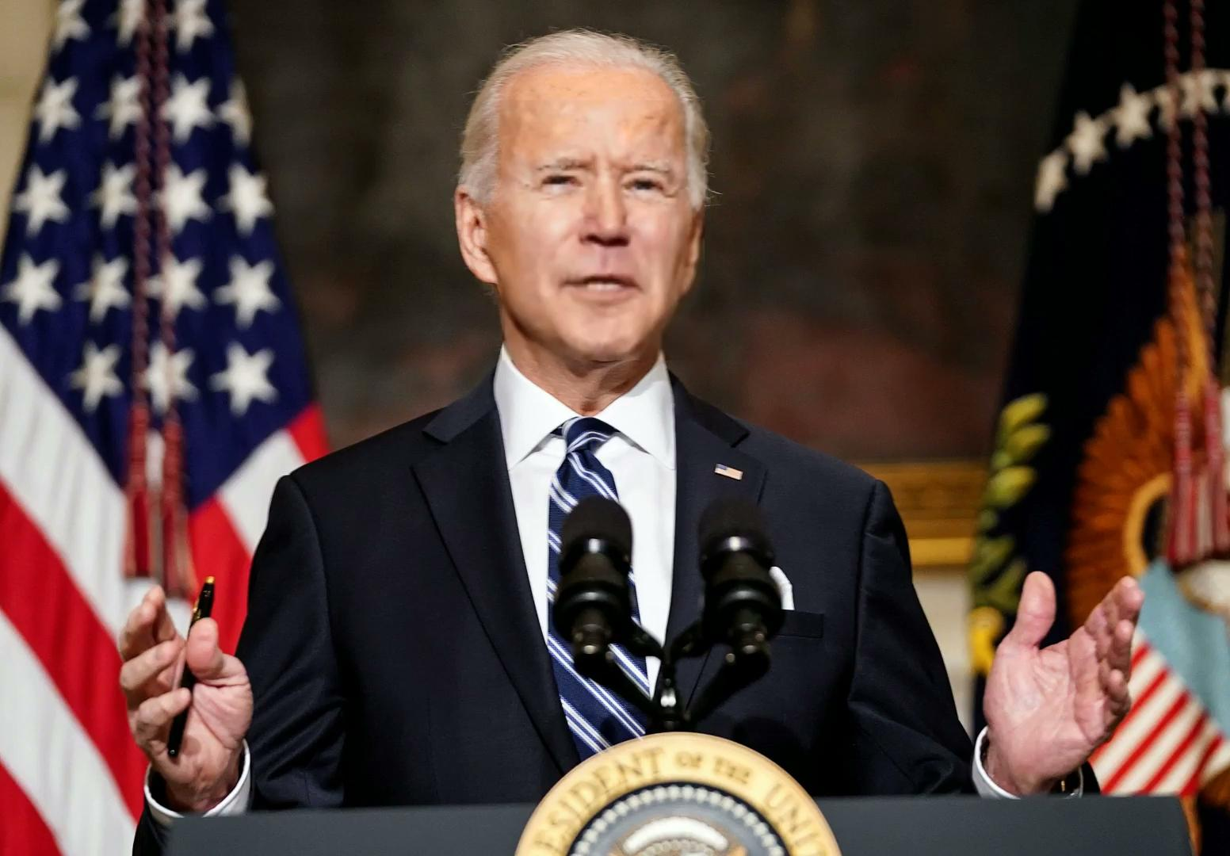
Results
Notes:
Here is an example of one of our generated talking face videos. This example only uses a still image and an audio recording.

Slide 6
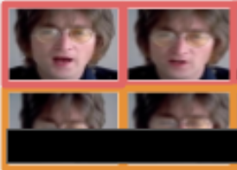
Experiments
Weighted L1 reconstruction loss
Idea: Lip reason contributes to less than 4% of the total reconstruction loss. Can we improve by focusing on the lip region.
Early epochs vs late epochs reconstruction loss.
Target pose prior(actual frame with masked lower portion): Generative model learns to
copy the remaining portion anyways. So, focusing on lip region is anyways redundant after few initial epochs.
Pixel level reconstruction is not a strong judge of lip-sync.
Notes:
Continuing further, we observed that Lip region contributes to only 4% of total face ares; or reconstruction loss.
We hypothesize that we can use weighted loss to have extra supervision around lip region.
Without weighted loss, the network starts to morph the lip region only at around half way through training process. (10 epoch or so)
Using weighted loss, even the earlier epochs start focusing on the lip region.
But after 15 epochs or so, both model achieve similar L1 reconstruction loss (MAE).
One justification could be- We are passing the target pose prior (which is shown in green box) , Generative model learns to copy that portion anyways. i.e focusing on lip region is redundant after few initial epochs.
I.e copy target pose prior is easier task than inpainting masked lip region, and both methods end up giving similar MAE after ~12-13 epochs.

Slide 7
Experiments
Discriminator Network
Idea: Can we add a additional discriminator in Multi-task setting.
In literature: Researcher have tried with Expert Lip-sync discriminator, which is not fine-tuned during model training. Having a Lip-sync expert (pre-trained) as an additional supervision helps to accurately discriminate and enforce lip-sync in generated images.
Testing discriminator network : ~63% on 1000 randomly generated lip sync face images (due to lot of artifacts due to large scale and pose variations)
Notes:
-In the literature, ppl have tried using an additional expert lip sync discriminator. Note this expert discriminator is pre-trained and not updated during the training process.
So, we wanted to establish the rationale behind how having an expert discriminator helps, so we evaluated our dicriminator model (learned as a part of GAN framework), and found that it is indeed not a good discriminator and have just around 60% accuracy.
could not try adding a new discrinator due to google colab gpu and storage limitations. More on that in later slides.

Slide 8
Limitations of LipGAN Model
Difficult to quantitatively measure shortcomings
Landmark Distance (the lower the better) Shortcoming: Just reducing lip movement globally (as in mumbling) will satisfy this.
PSNR: Developed to evaluate the overall image quality and not fine-grained lip sync error. Same for SSIM (Structural SIMilarity (SSIM) Index)
Notes:
There were few limitations we found with the LipGAN model.
Most of the quantitative measures has its limitations, and we need to depend on human evaluation.
For example, landmark distance which is the sum of pointwise movement of lip keypoints over a time period. The lower the better: This can be satisfied by just reducing the lip movement globally.
Similarly, other structural measure and PSNR were designed to evaluate the overall image quality and not fine grained lip sync error.
###################
One of the biggest challenges that we faced was that it was hard to have a quantitative measure of the model’s performance which could substitute human qualitative evaluation.
Although the aim was to ensure continuity in lip movement, no abrupt change.

Slide 9
Limitations of LipGAN Model
Difficult to quantitatively measure shortcomings
Spurious lip region detection
Notes:
We noticed that lip-sync generation has spurious movements on non-lip region, like lower chin or the side of the chin. We have observed that this happens when the face detection MODULE fails to correctly localize the lip region. We are using dlib facial keypoints detector.

Slide 10
Limitations of LipGAN Model
Difficult to quantitatively measure shortcomings
Spurious lip region detection
Profile face overcompensation / skewed lip sync
Notes:
Profile view of the detected face usually suffers from skewed lip movements i.e One side of lip has more movement than the other side.

Slide 11
Limitations of LipGAN Model
Difficult to quantitatively measure shortcomings
Spurious lip region detection
Profile face overcompensation
Issues with lip movement and audio synchronization. Especially, background music leads to high murmuring lip movement.
Notes:
Notice, how the background music leads to vibrating lips.. Audio encoder should distinguish between background sound and speaker sound.
Also notice how one side of lip has more lip movement than the other, due to presence of profile face.

Slide 12
Limitations of LipGAN Model
Difficult to quantitatively measure shortcomings
Spurious lip region detection
Profile face overcompensation
Issues with lip movement and audio synchronization
Teeth Deformation (crooked teeth) or no teeth at all
Notes:
In many cases, generated face images have crooked teeth, leading to very random/ discontinuous teeth contour,

Slide 13
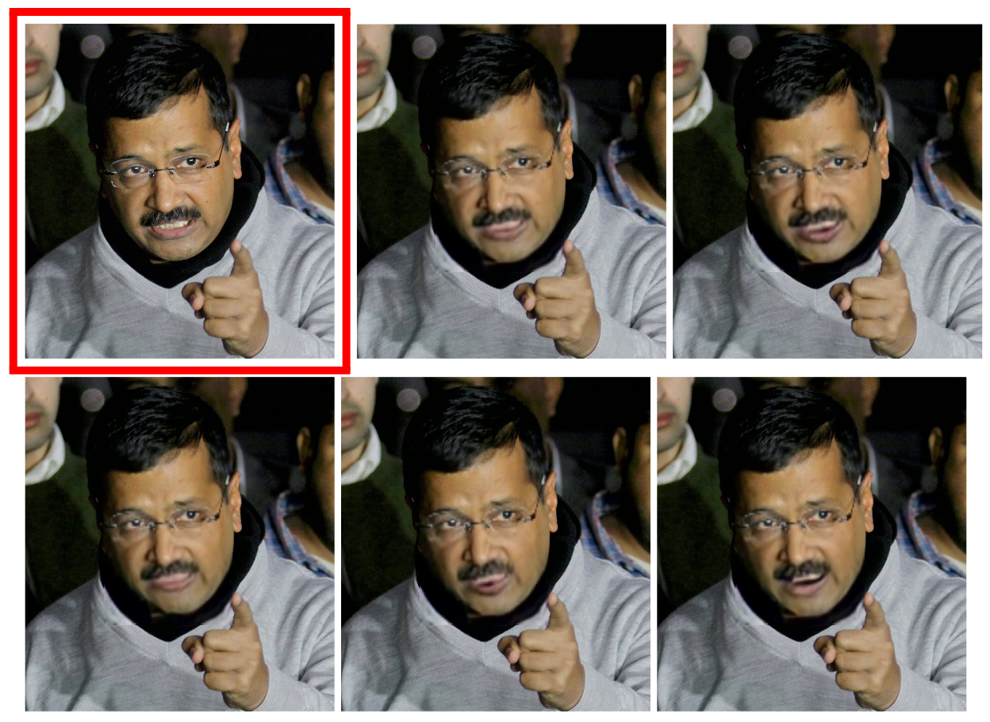
Limitations of LipGAN Model
Difficult to quantitatively measure shortcomings
Spurious lip region detection
Profile face overcompensation
Issues with lip movement and audio synchronization
Teeth Deformation
Limitations due to facial expression
Notes:
We also noticed that the model performs worse on faces with certain facial expressions . Like in deep frown.
Notice how the the generated face image have smoothed out the teeth and lip pixels.

Slide 14
Implementation Challenges
Computation time for preprocessing (~50GB raw data; ~30hr of video; ~10GB processed data)
Limitations due to use of Google Colab PRO (Session getting killed after certain time)
→ single gpu training took 3hr/epoch [Tesla P100]
→ ~71 M trainable parameters [Resnet50 had ~25M parameters]
Storage size limitation on google colab.
Notes:
We faced many implementational challenges- mostly due to the large dataset size and huge model trainable parameters
Another implementation challenge has to do with the limitations of Google Colab including running session timeouts and disk quota constraints.
##############
One implementation challenge that we faced early on was the fact that the LRS2 dataset acquisition and pre-processing tasks were not easy given its huge size (roughly 50GB). In order to resolve this issue, we downloaded the files to google drive and mounted a shared drive on Google Colab VM.
Another implementation challenge has to do with the limitations of Google Colab including running session timeouts and disk quota constraints.
Even having a google colab PRO subscription, it closes the job after a certain time (not fixed, usually 24ish hr). We had to be cautious not to exhaust google drive disk quota or File read-write operations.

Slide 15
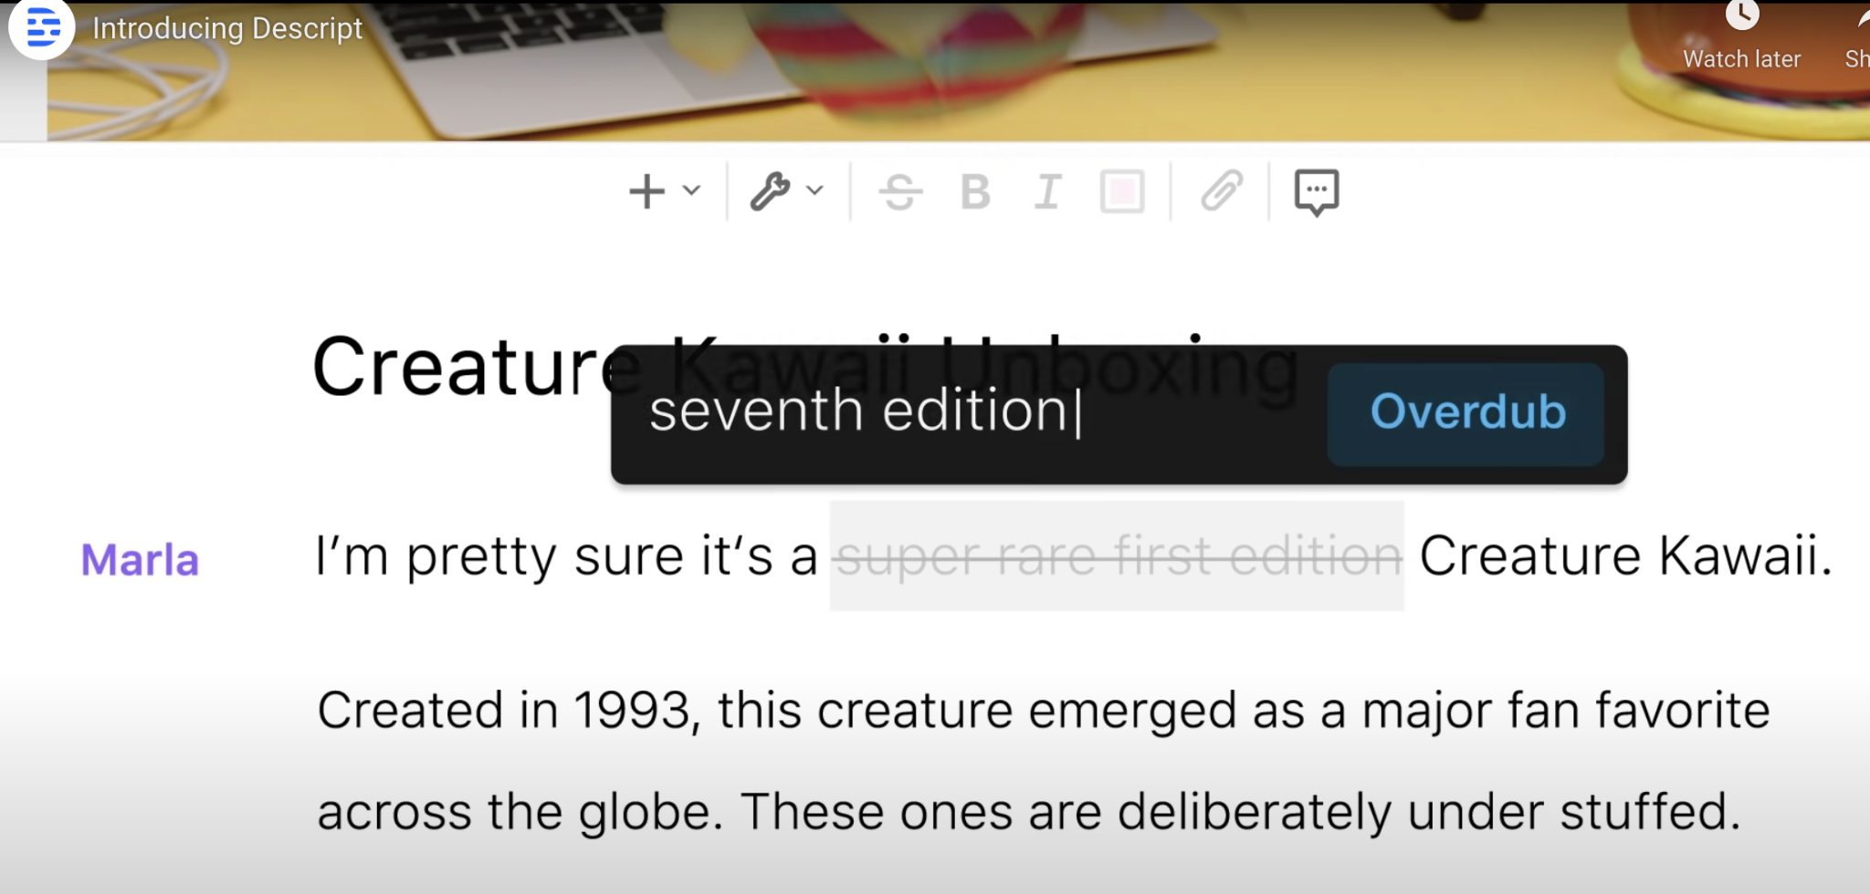
Discussion & Future Work
Similar model works best for editing/dubbing a small segment of a video. [lyrebird.ai]
Speaker independent; Language independent; Pose invariant.
Notes:
However, this model is way more useful despite its shortcomings.
Whenever we record, we tend to make some mistake that we want to modify later, but what if the error is in the middle of the video, we need to record it again;
One of my friend’s startup Lyrebird.ai solves that using lip syncing, basically you upload the video, it will generate the captioning, you just need to correct the captioning, and then it will OVER DUB the previous segment using the new text; it generates your voice and lip syncing.
########
We extensively discussed different categories of limitations;

Slide 16
Discussion & Future Work
Works well with animated cartoon as well, creating lip-synced bitmoji or AR emoji
Notes:
Not only person, we tried it on cartoons, it works reasonably well on cartoons characters too. (only thing we may need to modify the face keypoints detector module)

Slide 17
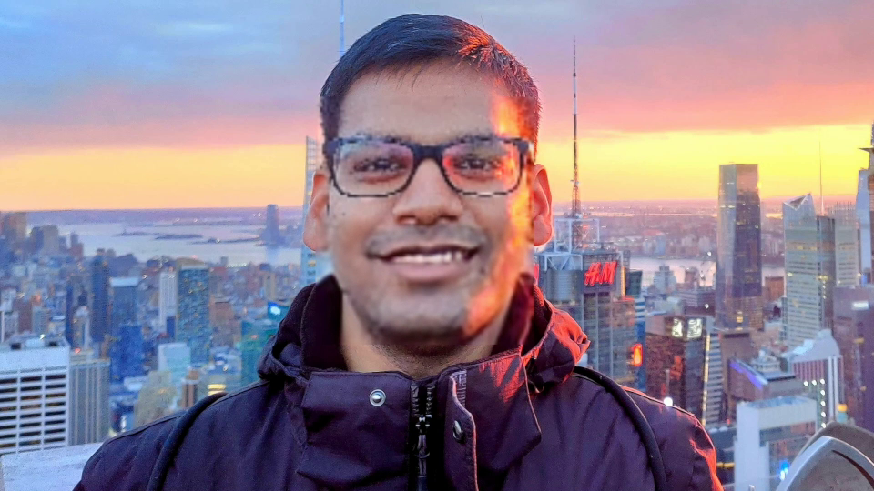
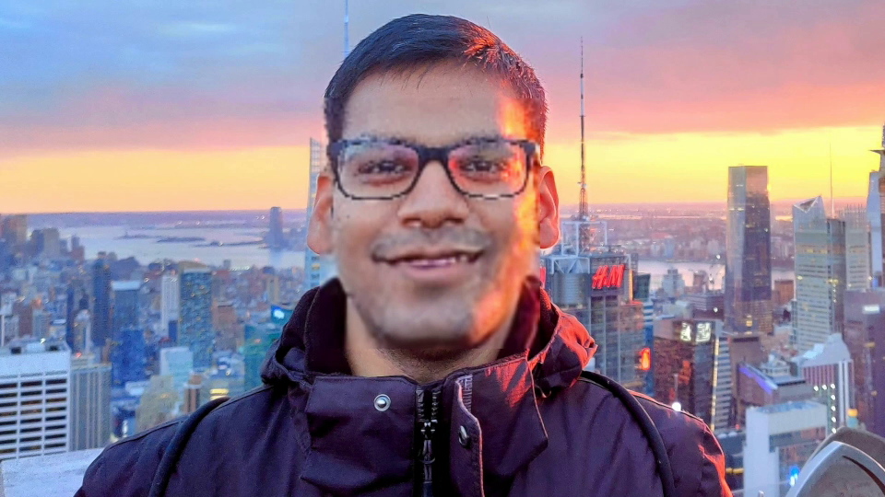
Discussion & Future Work
Need more detailed keypoint detector for lip region.
Worth trying out 3D representation of face, with mesh-like grid to have more structured and smooth lip movement along with side cheeks, jawline etc. (muscles getting pulled/pushed/squeezed)
→ will also enforce a sense of depth measure.
Million dollar idea: Live lip-syncing in video call (even if speaker is not sharing his video feed, we just need one static face image) → Live lip-synced video + privacy
Watch lip-synced dubbed movies/Tv series. I lip-synced 10 min of “Money Heist” (dubbed from Spanish to English) and I definitely liked the lip-synced version!!
Notes:
Here are possible future work or points worth exploring
It. Happens to most of us, that we don’t want to share video feed over zoom call, maybe privacy or any other reason. Then we can have a lip synced avatar or lip synced using your accout profile picture.

Slide 18
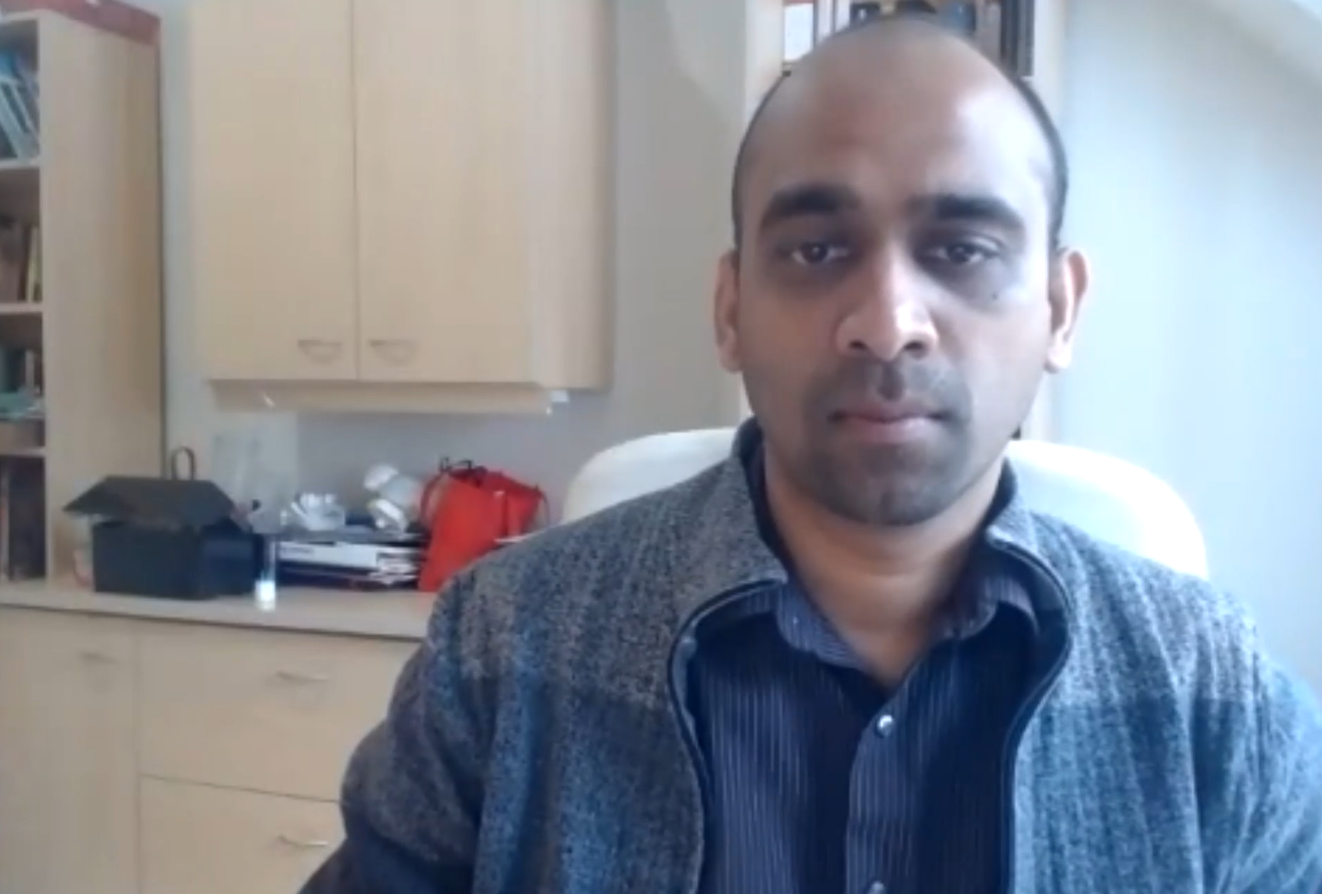
Privacy Matters!
“This group did a great job.”
But, we did NOT!
PLEASE Take prior permission before publishing Lip-synced videos!!!
Notes:
We wanted to make a lip synced video of prof saying that we did a great job; but we did not, as we did not take prior permission. This is just to RE-ITERATE that please be mindful of privacy if you do use similar models.
#############
Current DL trends it easier and easier to manipulate speech and video media
Even human evaluators can’t reliably tell if they’re real or fake …this is very impressive, but they also present a serious issue if they are in the wrong hands. . As the saying goes, with this great power comes great responsibility.

Slide 19
One last demo!
English Translation: “I have wanted you so much, so truly ... that the entire universe has conspired for me to get you” (Hindi Movie dialogue)

Slide 20
References
https://medium.com/deepgamingai/automate-your-lip-sync-animations-with-this-ai-lipgan-ad35551ae62d
https://arxiv.org/pdf/1803.10404.pdf
http://cdn.iiit.ac.in/cdn/cvit.iiit.ac.in/images/Projects/facetoface_translation/paper.pdf
https://arxiv.org/abs/2103.00484
https://arxiv.org/pdf/2005.08209.pdf
https://arxiv.org/pdf/2008.10010.pdf
https://arxiv.org/pdf/1705.02966.pdf
https://github.com/Rudrabha/LipGAN/tree/fully_pythonic
https://www.bbc.co.uk/rd/projects/lip-reading-datasets [dataset]
https://www.robots.ox.ac.uk/~vgg/data/lip_reading/lrs2.html
https://colab.research.google.com/
https://www.descript.com/lyrebird https://www.descript.com/video-editing

Slide 21
Questions?

